Slide 1
EE Trauma Response Times in Southwestern PA
2000-2003
Kevin Andrew Lipscomb, BS, NREMT-P
Assistant Executive Director
EMSI

Slide 2
Design
Retrospective study of lagging indicators
All data came from EMSCAN
Interested in cases where all stakeholders probably agree (before and after incident) that best response time of ambulance is significant.

Slide 3
What EMSCAN doesn’t do
Says nothing about EMS system design
Consider continuum:
  No first response component
  :
  Strong ALS first response component

Slide 4
Interest, elaborated
Response time of ambulance may not be as important if:
  Case is not dispatched as emergency
  First responder explicitly downgrades incoming units
  Personnel capable of initial stabilization are already with patient:
    Interfacility transports
    EMS system design includes strong ALS First Responder component

Slide 5
Inclusion criteria
MCD code in EMSI region
Incident Type was entered and was not Interfacility or Medical
Pt condition on scene not Minor
Response Mode was Emergency
Pt was transported
Transport Mode was Emergency
Notes:
SELECT [emscan-data].[mcd-code], [emscan-data].[dispatch-time], [emscan-data].[response-time], [emscan-data].[incident-type], [emscan-data].[pt-cond-on-scene], [emscan-data].date INTO tblAlsTraumas
FROM [emscan-data]
WHERE ((([emscan-data].[mcd-code]) Like "02*" Or ([emscan-data].[mcd-code]) Like "03*" Or ([emscan-data].[mcd-code]) Like "04*" Or ([emscan-data].[mcd-code]) Like "10*" Or ([emscan-data].[mcd-code]) Like "26*" Or ([emscan-data].[mcd-code]) Like "30*" Or ([emscan-data].[mcd-code]) Like "32*" Or ([emscan-data].[mcd-code]) Like "37*" Or ([emscan-data].[mcd-code]) Like "63*" Or ([emscan-data].[mcd-code]) Like "65*") AND (([emscan-data].[incident-type])<>"00" And ([emscan-data].[incident-type])<>"06" And ([emscan-data].[incident-type])<>"07") AND (([emscan-data].[pt-cond-on-scene])<>"03") AND (([emscan-data].date)>=[From date:] And ([emscan-data].date)<=[To date:]) AND (([emscan-data].[response-mode])="1") AND (([emscan-data].[transport-mode])="1") AND (([emscan-data].[response-outcome])="01"));

Slide 6
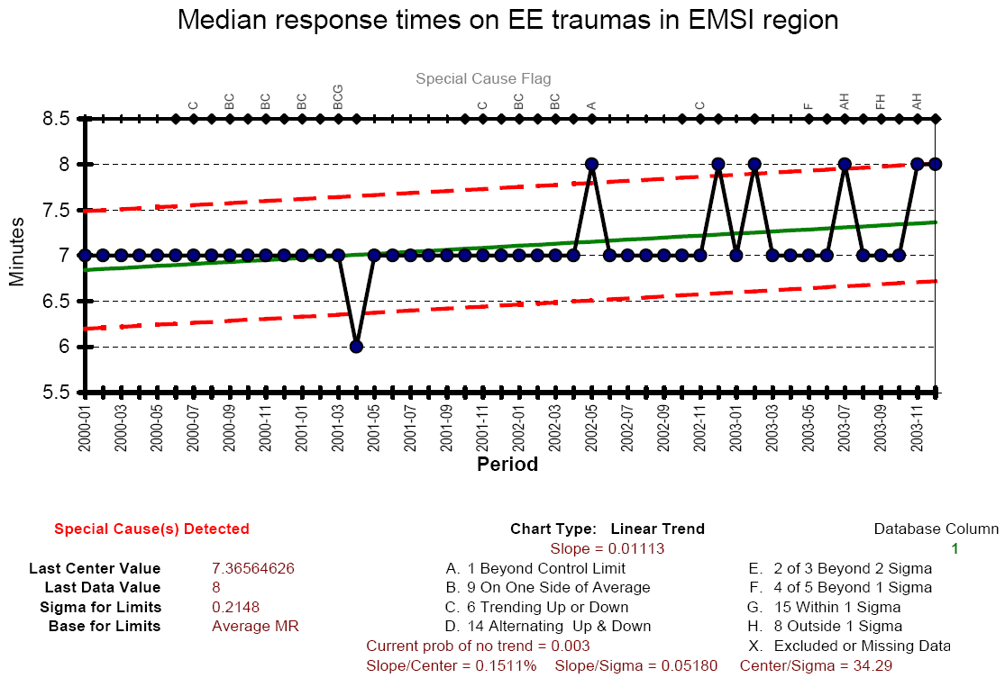

Slide 7
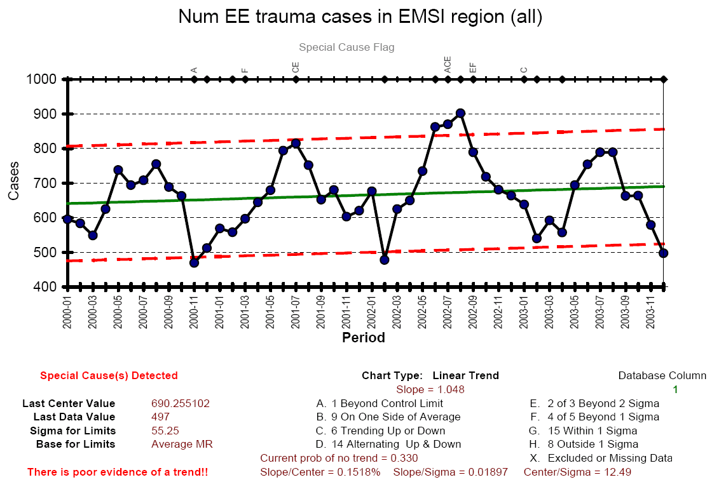

Slide 8
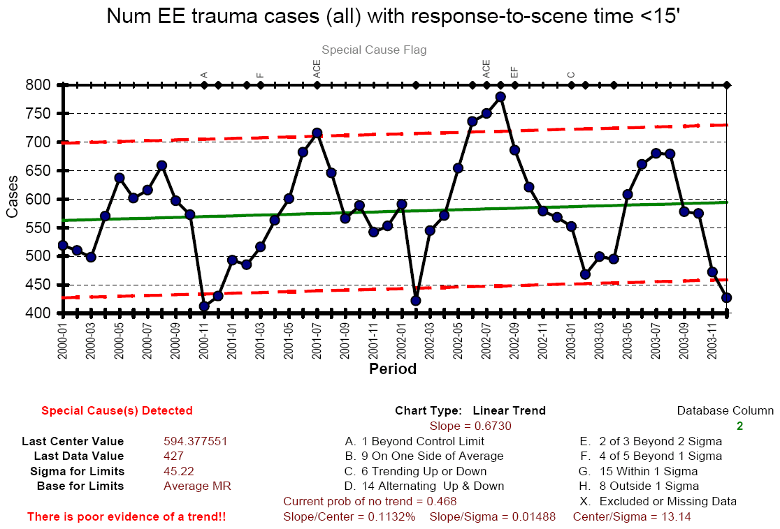

Slide 9
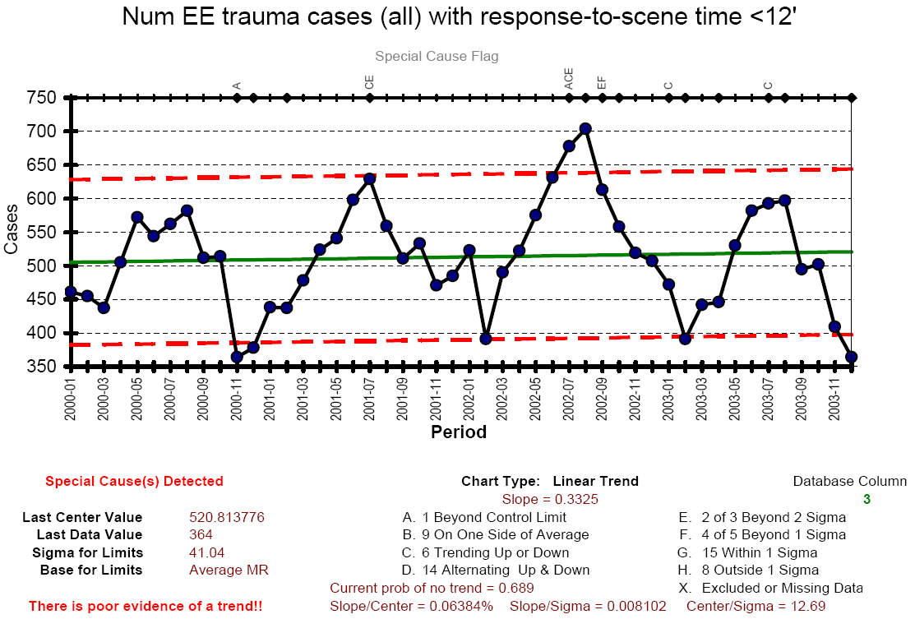

Slide 10
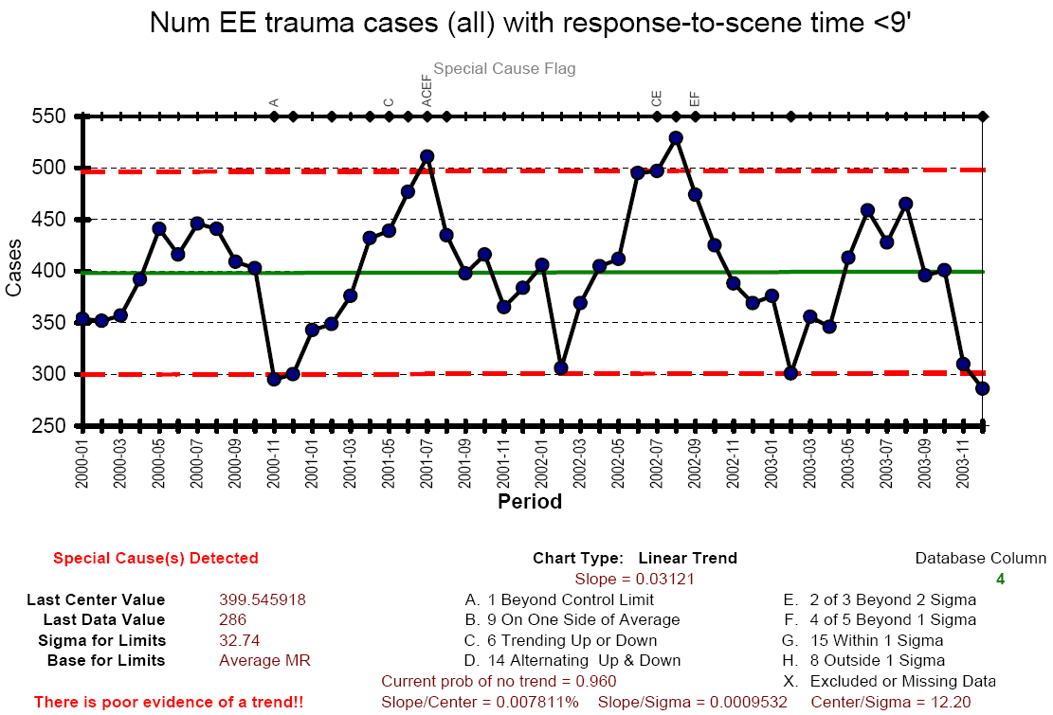

Slide 11
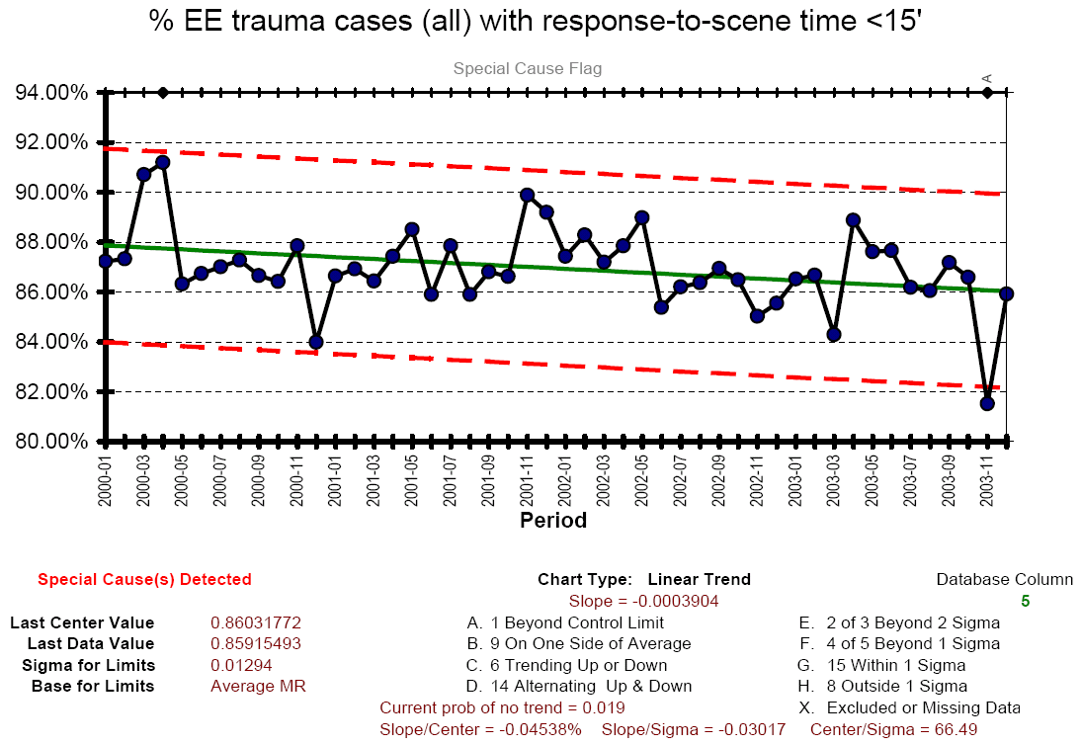

Slide 12
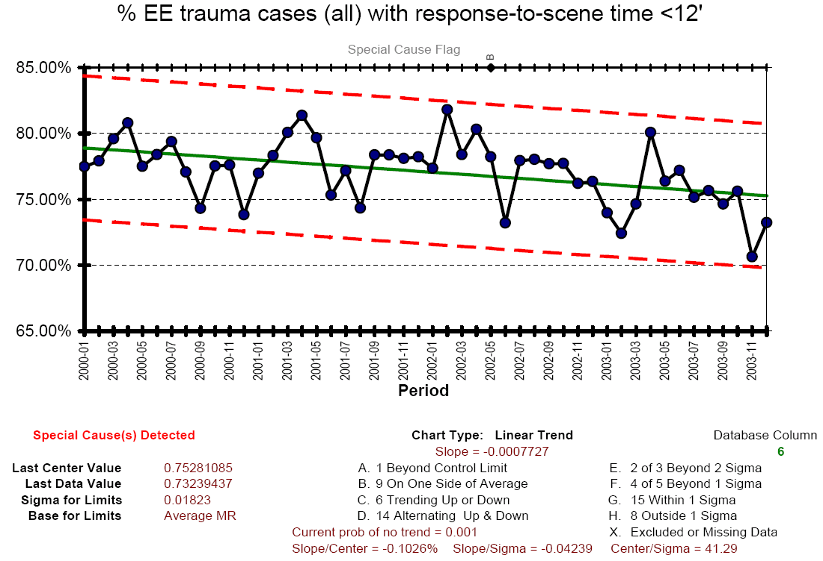

Slide 13
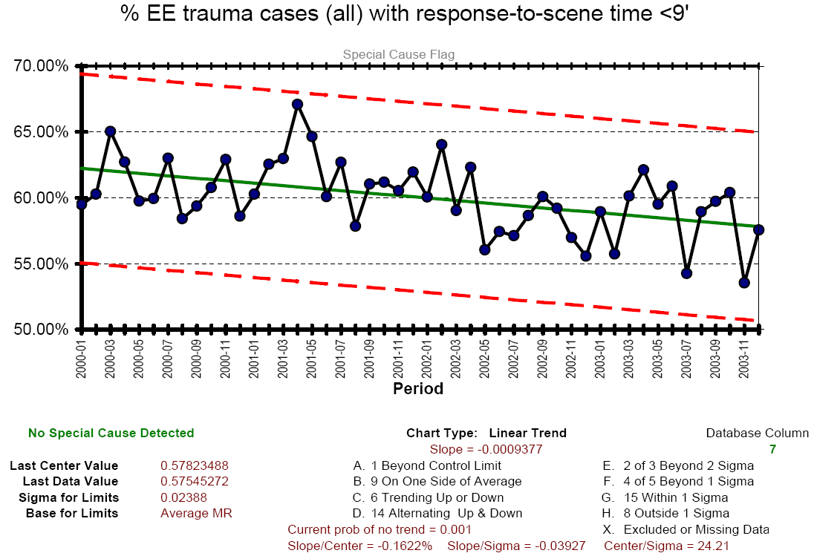

Slide 14
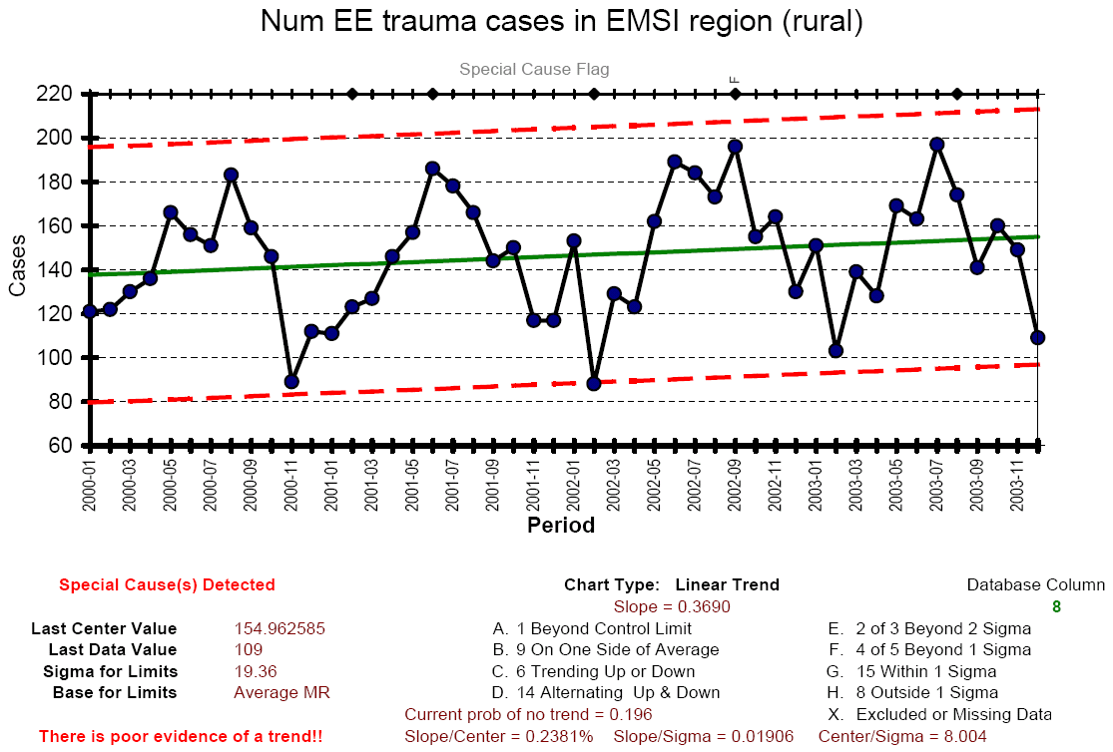

Slide 15
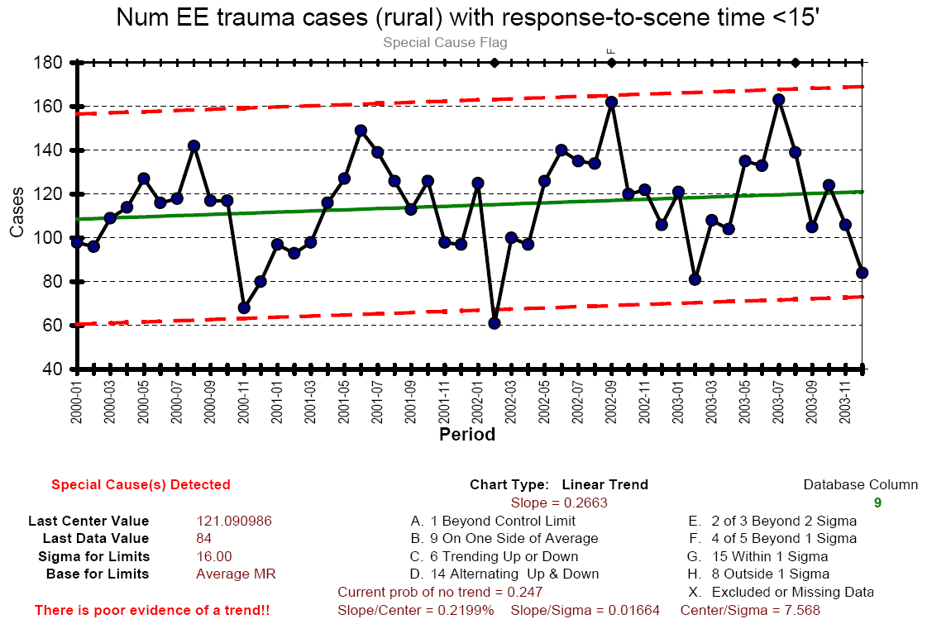

Slide 16
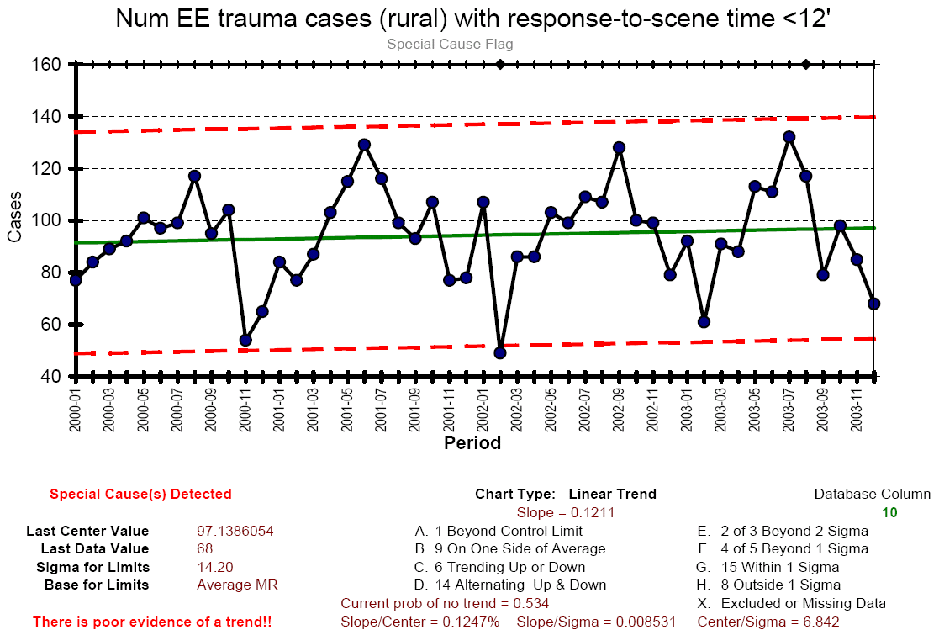

Slide 17
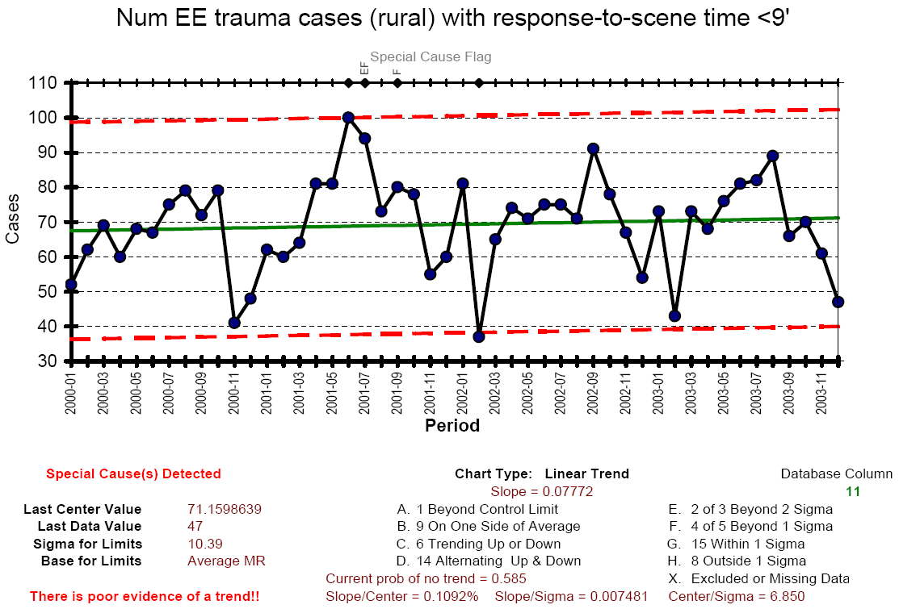

Slide 18
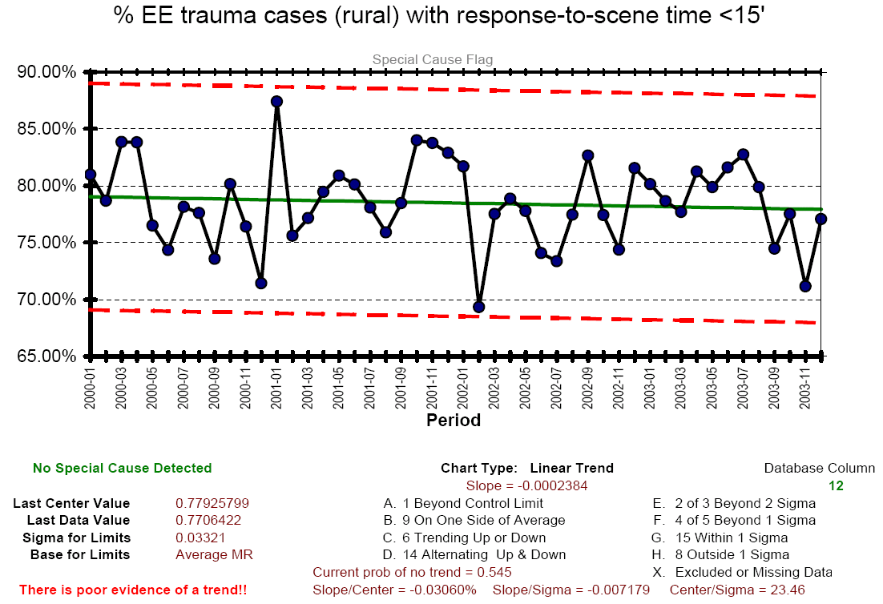

Slide 19
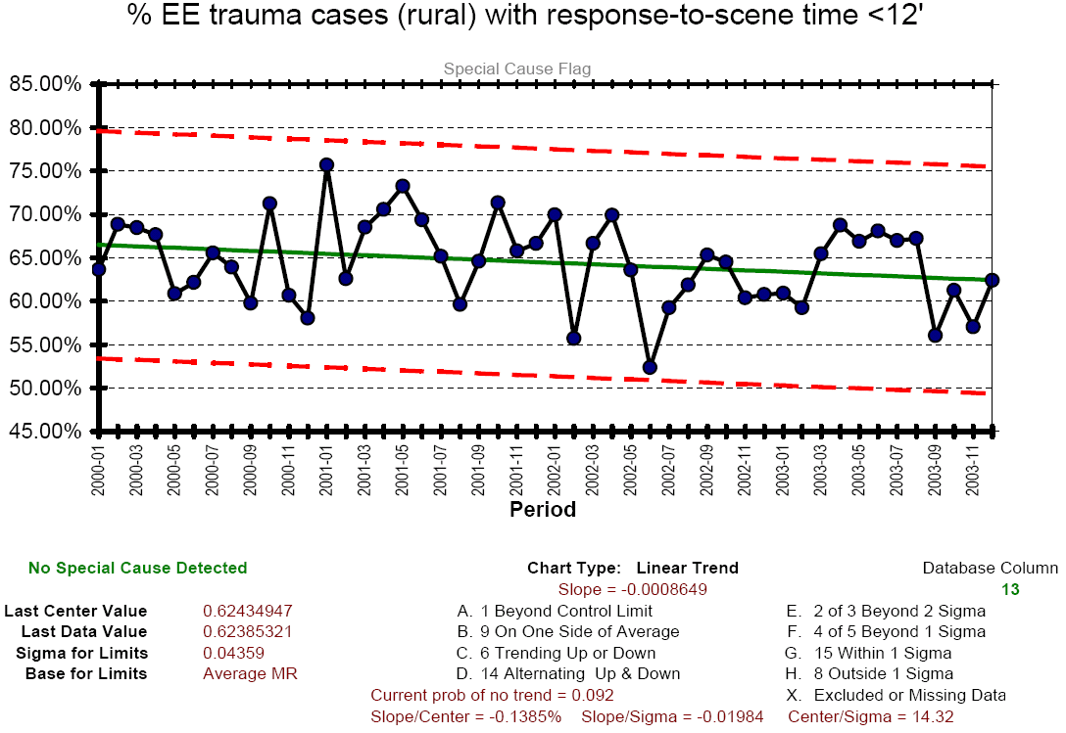

Slide 20
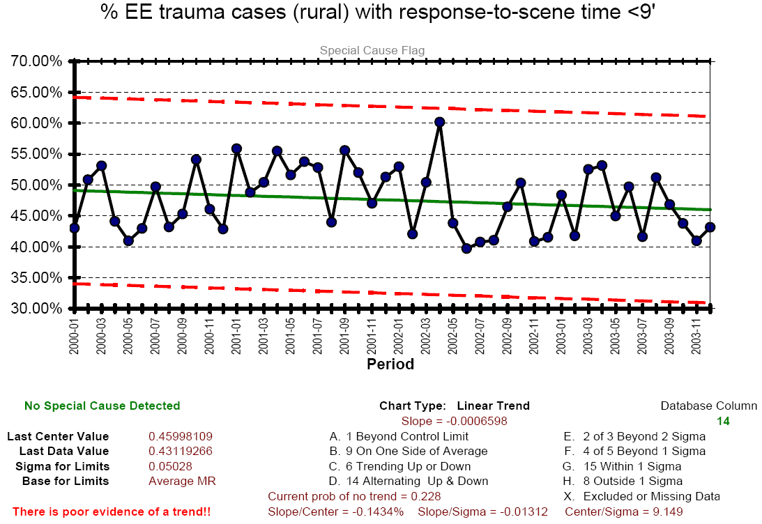

Slide 21
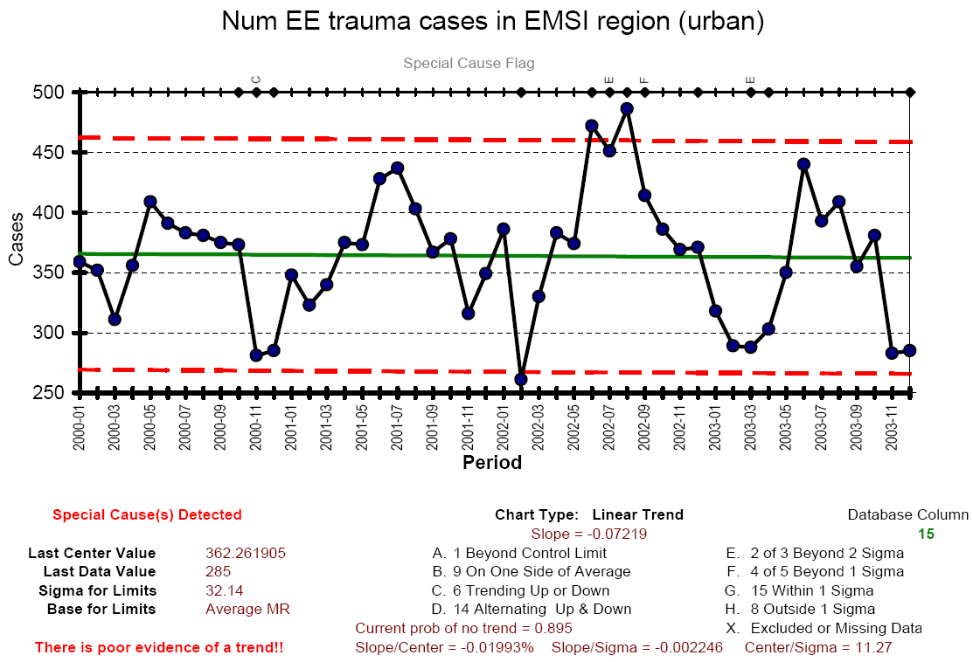

Slide 22
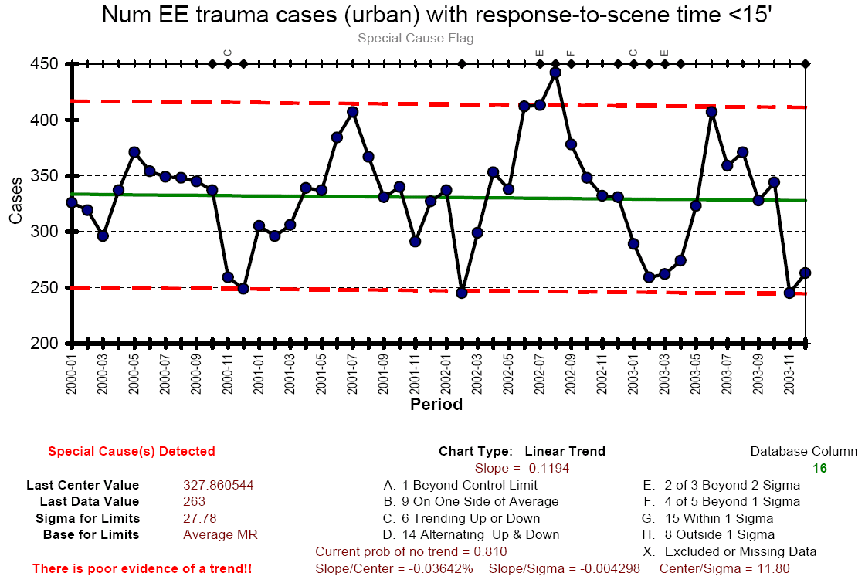

Slide 23
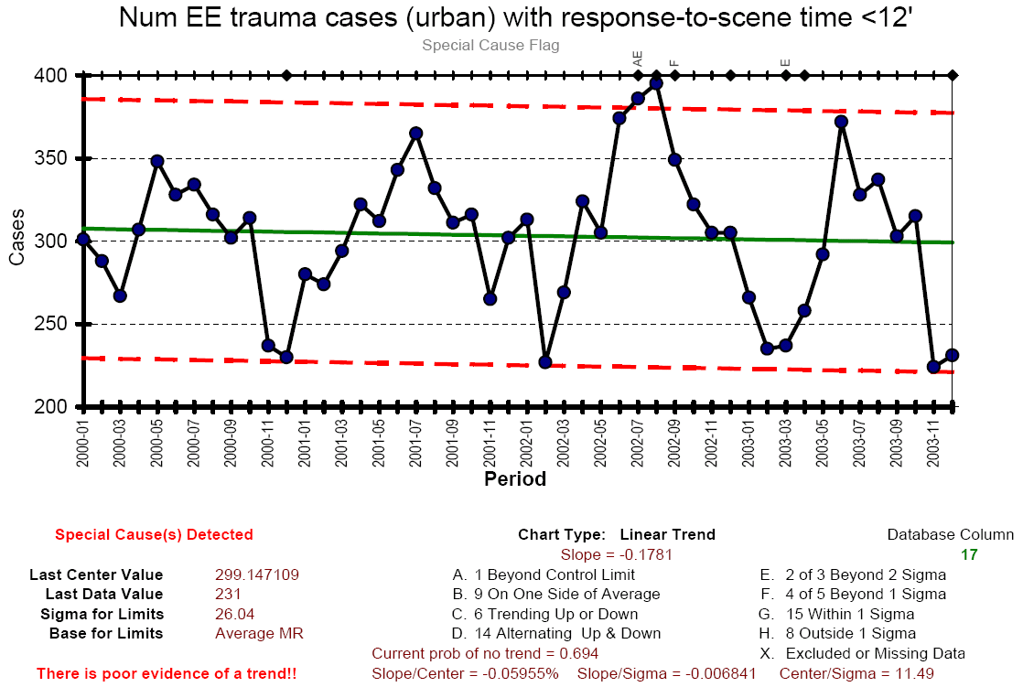

Slide 24
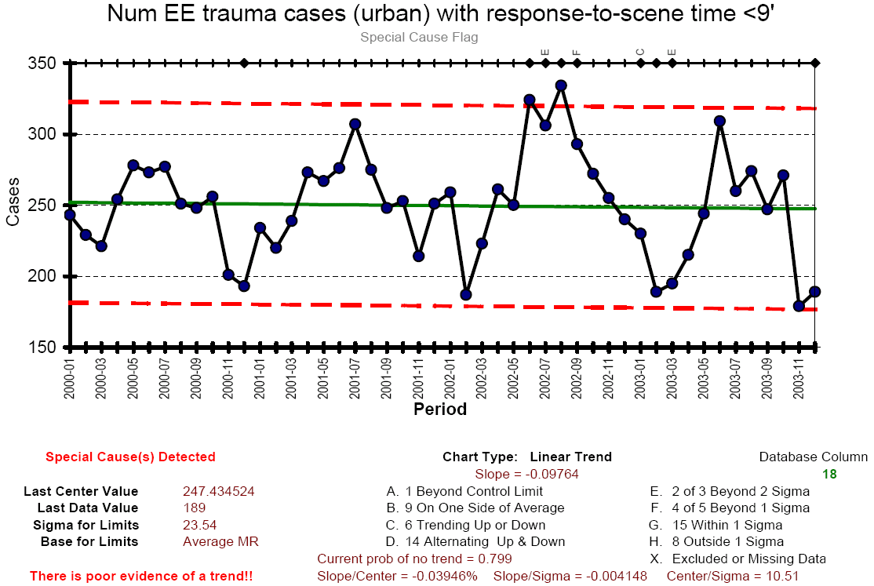

Slide 25
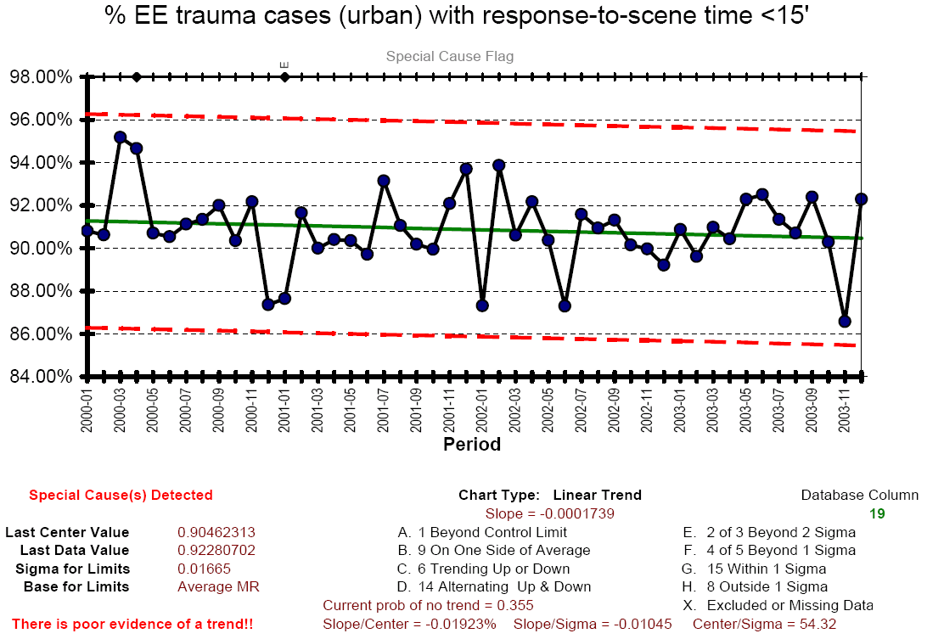

Slide 26
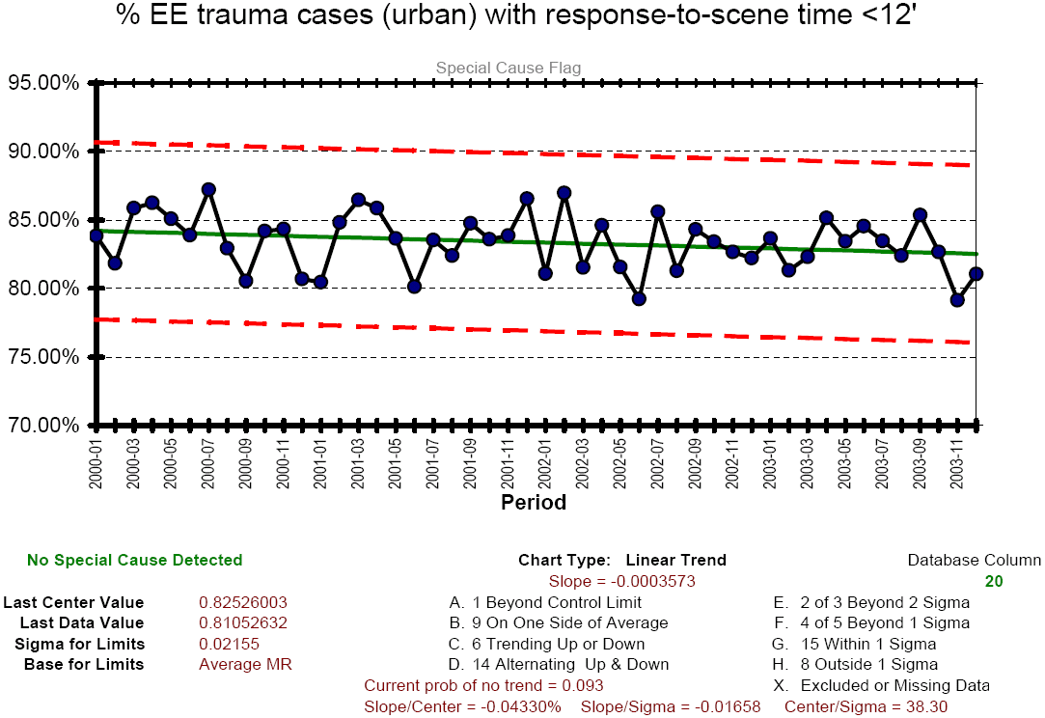

Slide 27
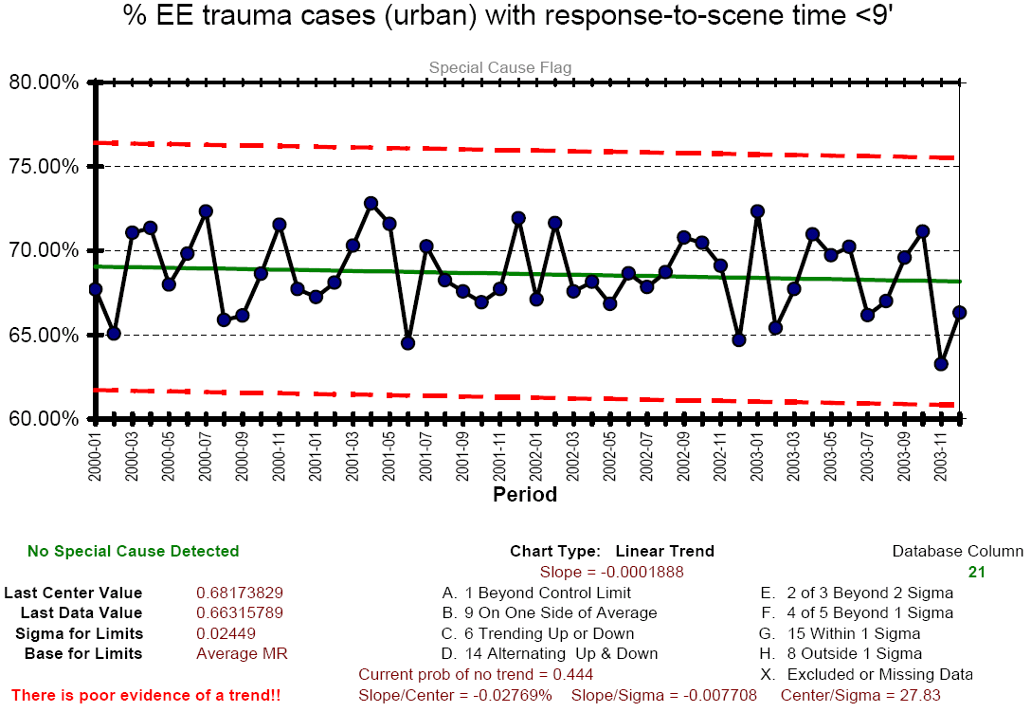

Slide 28
Conclusions
Strength of evidence for urban flight hypothesis is low.
High confidence in three areas...

